Slide 1
Power BI Adoption Framework
Empower every decision maker
How to secure

Slide 2




Data Security
Row-Level Security
Roles
Import or Direct Query
Analysis Services Inherits

Slide 3




Dynamic Row Level Security
Dynamic
Reduces Maintenance
USERNAME()
USERPRINCIPALNAME()

Slide 4
Sharing
App Workspaces / Apps
Reports & Dashboards
Public
Printing

Slide 5


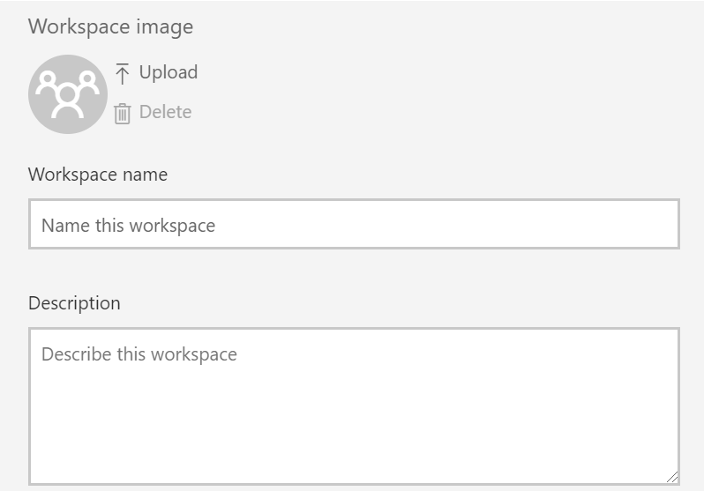


Collaborative Development
Anyone can Create
Workspace OneDrive
Belong to Many
Pro License
Sharing
App Workspaces

Slide 6



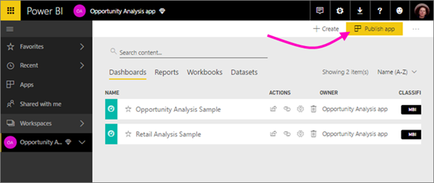


Sharing
Requires App Workspace
Multiple Assets
Broad Audience
Read-Only
Download or Push
Staged Changes
Pro or Premium
Apps

Slide 7


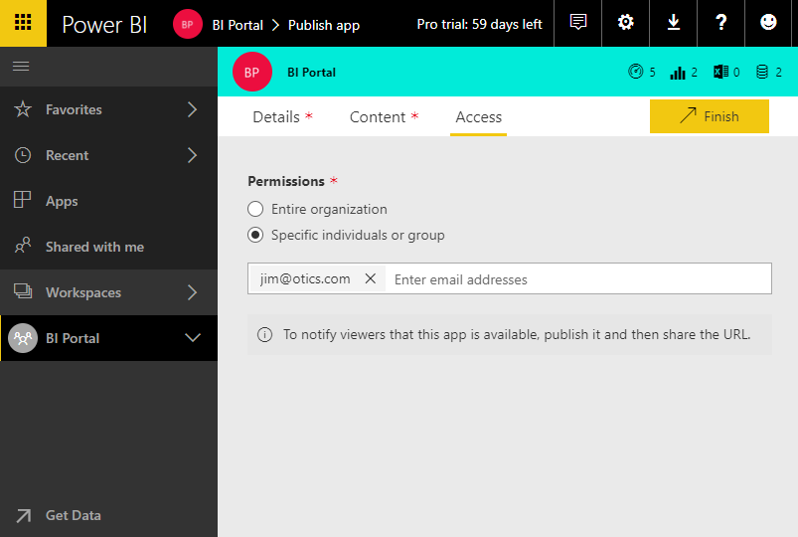
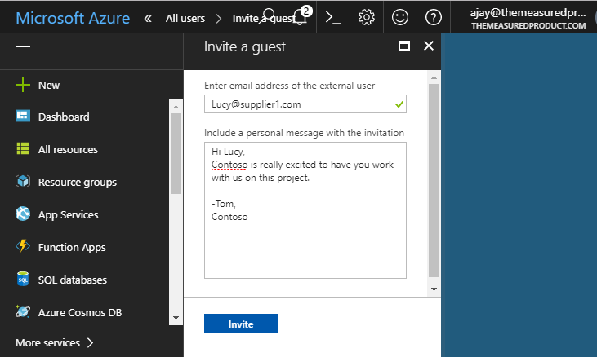
External Users
Any Email Address
Planned or Ad-hoc Invites
App sharing
Pro or Premium
Sharing
AAD B2B

Slide 8
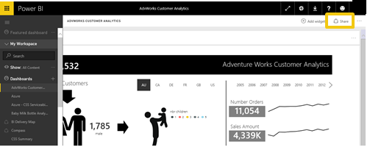
Sharing
Share from Anywhere
Read-Only
External Users
Pro or Premium
Reports & Dashboards

Slide 9



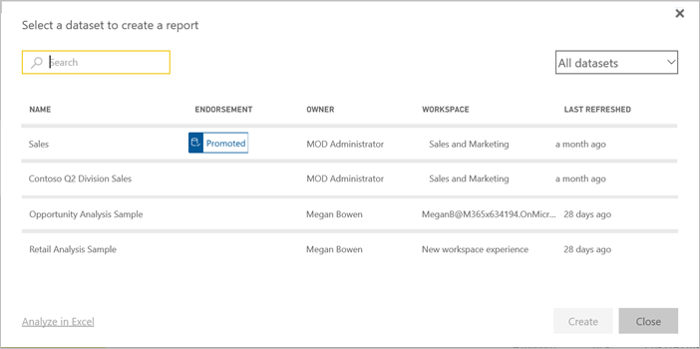

One Source of Truth
Cross Workspace
Certify
Promote
Pro or Premium
Sharing
Dataset

Slide 10

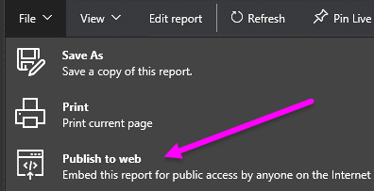

Sharing
Publicly available
Embed on Websites
Data Refresh
Public

Slide 11


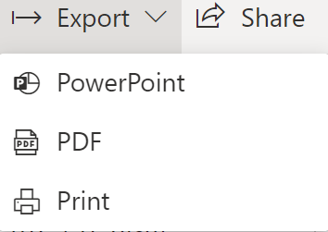

Entire Dashboard or Tile
Report page or Visual
Single Page
Export to PDF
Sharing
Printing
PDF

Slide 12




Each page becomes a slide
Single image in PowerPoint
Filters are preserved
Has a link to the report
Sharing
PowerPoint

Slide 13
When should you use the various sharing options?
Share Individual Dashboards / Reports
App Workspaces
Apps
Audience Size
Small
Small
Large
Common Scenario
One off sharing
Development, i.e. collaboration with edit permissions
Content Distribution; View access
Type of Users
Individuals
Distribution Groups
AD security groups
Does NOT work with Dynamic Distribution Groups
Individuals
Security Groups (new Workspaces – in preview)
Distribution Lists (new Workspaces – in preview)
Office 365 Groups (new Workspaces – in preview)
Everyone
Individuals
AD Security Groups
O365 Dependency
No
Current workspaces create an 0365 group, but Workspaces currently in Preview do not.
No
License Requirements
Pro License or PBI Premium
Pro License
Pro License or PBI Premium
References
Share your Power BI dashboards and reports with coworkers and others
Create workspaces with your colleagues in Power BI
Create the new workspaces (preview) in Power BI
Publish apps with dashboards and reports in Power BI

Slide 14
Thank you

